Slide 1

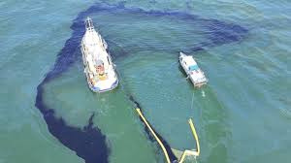





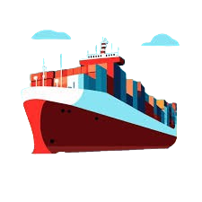
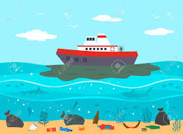
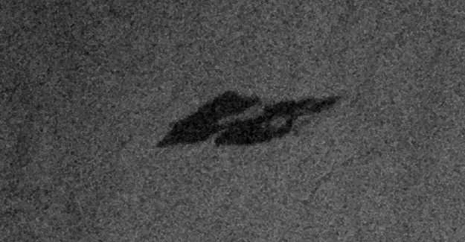











WORK FLOW
SHIP
SHIP SPILLING OIL
SAR IMAGE DEDECTION
SATELLITE
COLLECTS DATA
AIS INFORMATION
GPS TRACKING
+
THROUGH GPS
COLLECTS DATA
ALERT TO SHIP PORT

